Slide 1
Space Careers Wayfinder Humans in Deep Space
Background
From the second a crew enters a space craft they are faced with countless hazards and challenges. Even before the craft leaves the Earth’s surface, they find themselves atop huge cylinders filled with highly flammable fuels, typically around 400 000 kilograms or 300 000 litres. As the craft accelerates to a top speed in excess of 40 000 km/h crew members experience a gravitational force around 3 G, this is 3 times the force normally felt on the earth’s surface.
Once off the ground the crew face higher levels of radiation, the effects of microgravity, hostile space environments etc.
The task
Use the internet and other sources to complete the table on the next page identifying the hazards and challenges faced by a crew in deep space. These might have physiological and psychological effects. Describe how the risks are minimised.
https://www.youtube.com/watch?v=TZkuQUCUYgM

Slide 2
Humans in Deep Space – page 2
Hazard/Challenge | Effect/Impact | Mitigation!
Launch pad potential explosion/fire | Fatality, critical or severe injury. | Mission abort protocol. Launch pad water deluge systems.
Radiation |  | Forecasting the Sun’s solar energetic particle ejections. Magnetic shields.
 | Reduced flow of blood to the eyes. Reduced flow of blood to the head with possible blackout. | Gravity suit which contains an air bladder. Air bladder inflates preventing blood pooling in the feet and legs.
Collision with other objects in space | Fatality, critical or severe injury.
Microgravity |  | Aerobic and resistive exercise. Pressure cuffs/lower body negative pressure suit.
Hostile environment (Temperature and vacuum in deep space) | Air drawn from lungs causing suffocation, water in the body would boil with swelling of body tissue.
Isolation |  | Psychological screening and rigorous assessment including Temperament Structure Scale (TSS) and a NEO Personality Inventory-Revised (NEO PI-R) Intensive training in space analogue environments.
 | Injury, illness, possible fatality. | Training SMART medical systems including telemedicine. Flight surgeon who overseas health care and medical training of crew. And conducts weekly private medical conference with each crew member.
Water and food | Starvation, dehydration potentially fatal consequences.
Breathable air and essential items |  | Initially liquid oxygen in tanks eventually splitting water into hydrogen and oxygen, air filtration system. Exercise equipment etc.
Personal hygiene and bodily functions | Dental caries, unpleasant odours, bacterial infections
 | Life support systems fail, means of manoeuvring space craft lost. | Solar panels, batteries, fuel cells.
Navigation | Spacecraft and crew lost indefinitely resulting in fatality, collision with another object.
Communication |  | Deep Space Networks, development of optical communication systems using laser technology.
SPACE CAREERS WAYFINDER IS A COLLABORATION BETWEEN THE CSIRO AND THE AUSTRALIAN NATIONAL UNIVERSITY

Slide 3
Space Careers Wayfinder Identify and label effects of prolonged space travel on the human body
2. Identify the major organs/systems of the body which are affected by long term space flight. Use the internet to add images for the organ/system or sketch them on the body on the next page. Include the likely impact on the organ/system from long term space flight.

Slide 4
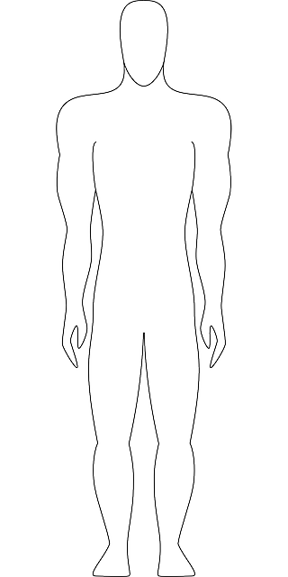
Identify and label effects of prolonged space travel on the human body – page 2
SPACE CAREERS WAYFINDER IS A COLLABORATION BETWEEN THE CSIRO AND THE AUSTRALIAN NATIONAL UNIVERSITY

